Slide 1
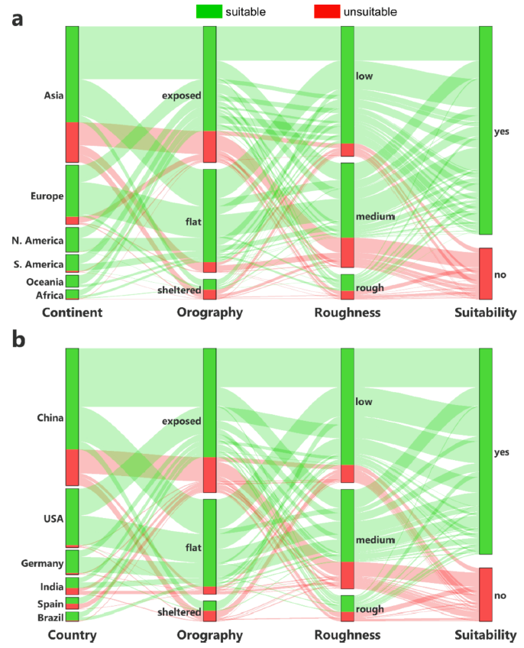
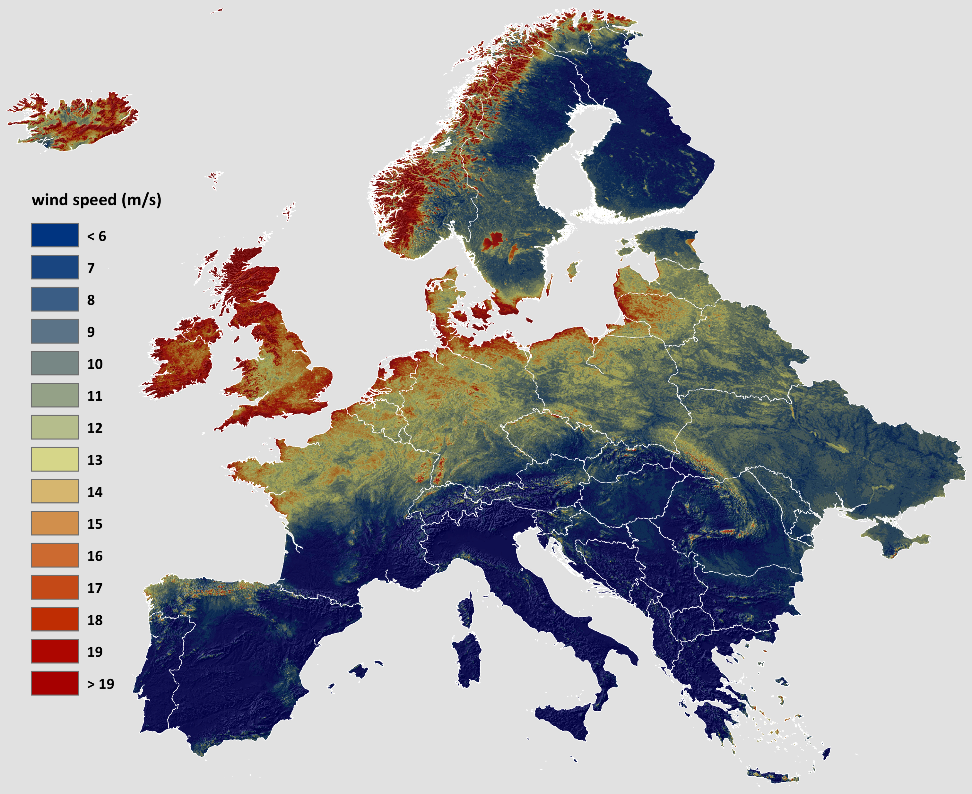
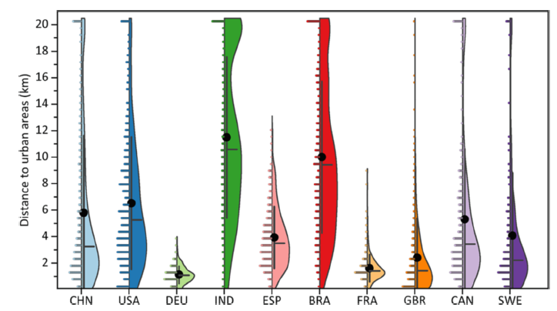
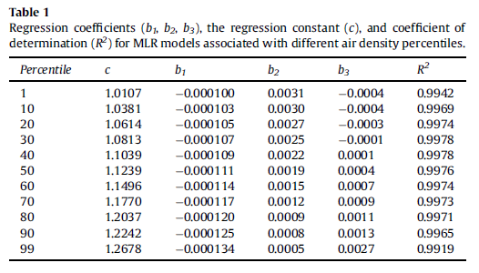
Title
Authors
Introduction
…
…
…
Methods
…
…
…
…
Results
…
…
…
Discussion
…
…
…
Additional info
…
…
Main finding goes here,
translated into plain English.
Emphasize the important words.
Place main display item here
Download the poster

